Slide 1

MODERN FARM BREACHING
TEAM MENBERS
1]2010030015-ANIL
2]2010030015-SAI RISHAL
3]2010030288-DILEEP SAI

Slide 2
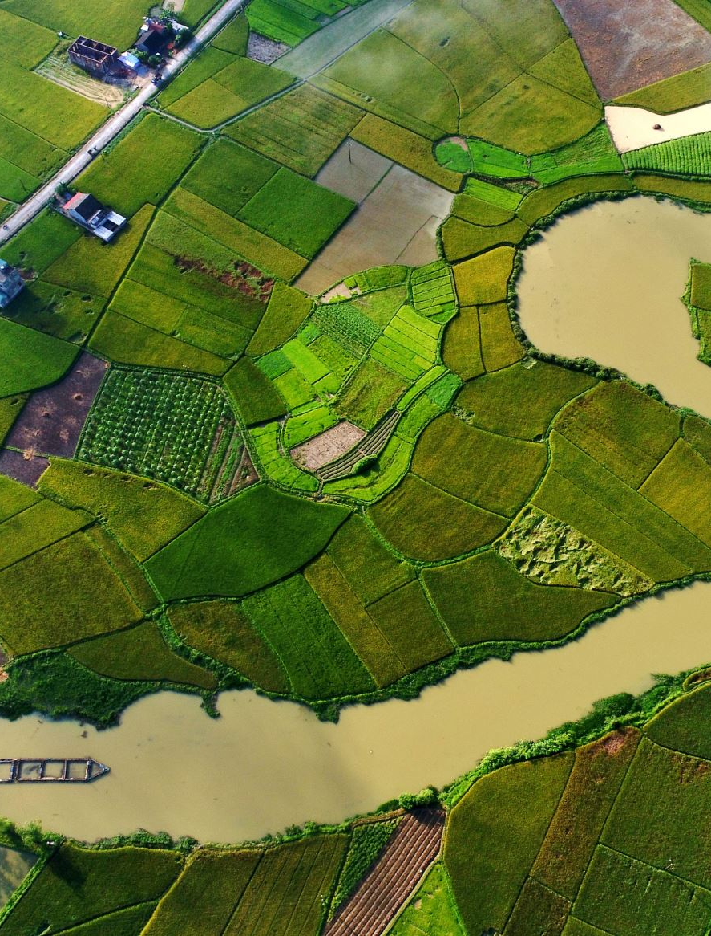
ABSTRACT
Seventy per cent of the total population of India is depended on agriculture, and with the deteriorating conditions, farmers are going below the poverty line.
Agriculture now-a-days became so easy by the use of various mechines but there are even more problems that are not solved yet .
One of the problem we get to know is Breaching manually while Rainfalls .Our idea is to implement Breaching through small farm dams without any manually work.

Slide 3
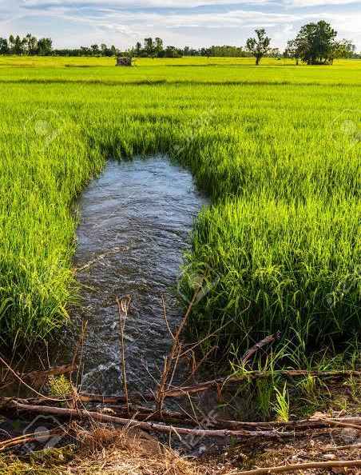
INTRODUCTION
BREACHING
In case of heavy rainfalls Farmers face a lot of problems :The crops which are submerged in water will die due to inability to exchange atmospheric gases to avoid this situation they follow the process called “Breaching” it is the way of making a way to letting the water out of the field as "the river breached its bank"

Slide 4
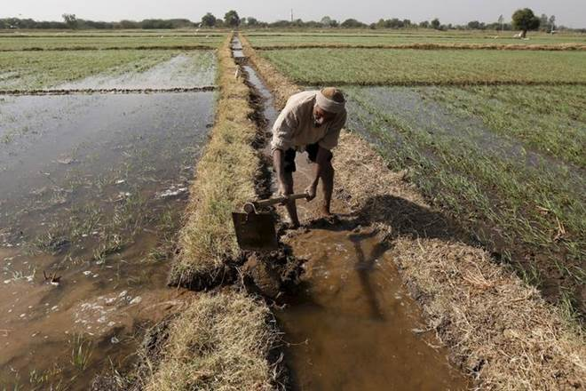

IMPLEMENTATION
In this project we will use small farm dams and sensors for leveling the water in the field. So that the crops doesn’t absorb more water, as by absorbing more water the crops might be submerged due to more water level in the field. The excess water in the field are routed to another field that are adjacent to the current field. The water level in the field is detected by the IR(infra-red) sensor. So by sensing the water level, the excess water in the field is routed to the alternate field, if the alternate fields are also reached their water level the excess water is now transferred through canals to the nearest water resource.

Slide 5
METHODOLOGY
OBJECT TO SENSE WATER LEVEL
PIR SENSOR
TRANSISTER
DC MOTOR
WATER SWITCH
ARDUINO MEGA

Slide 6
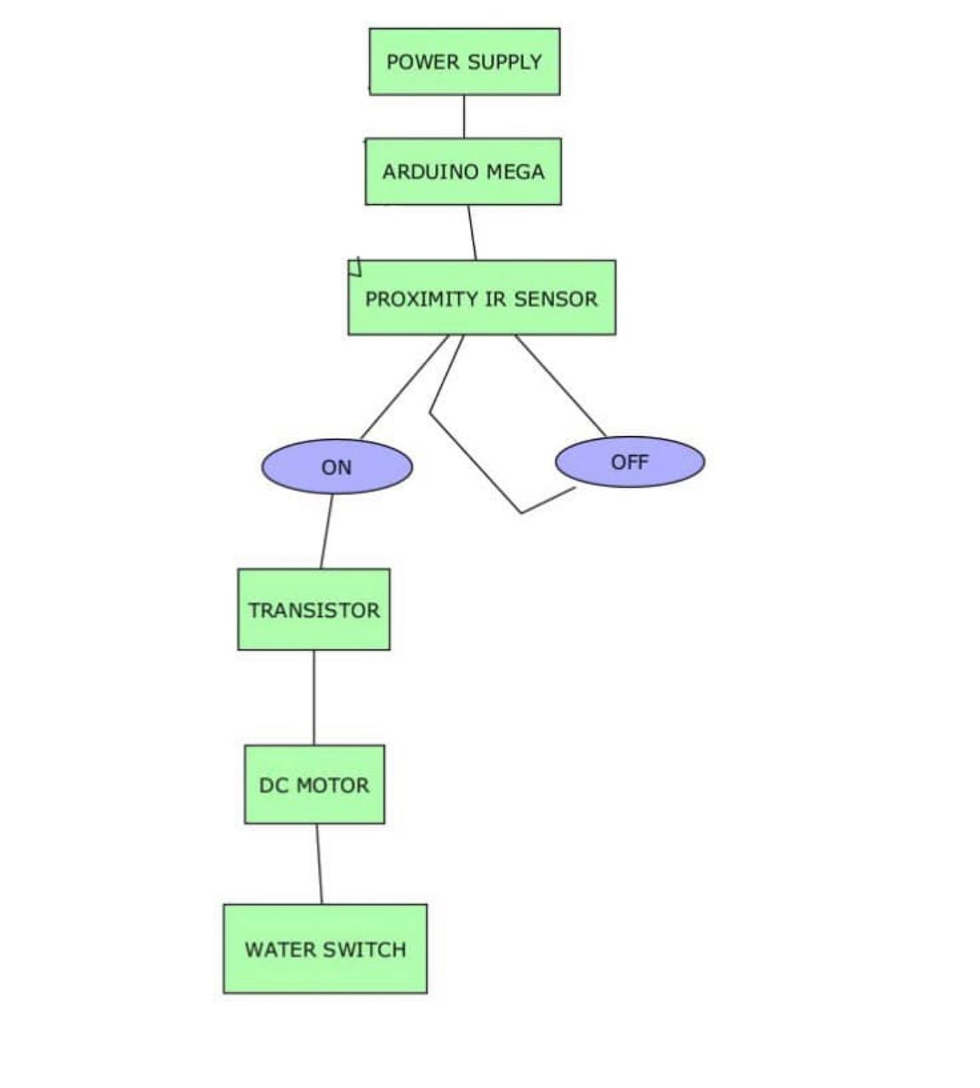
STEPS TO IMPLEMENT

Slide 7
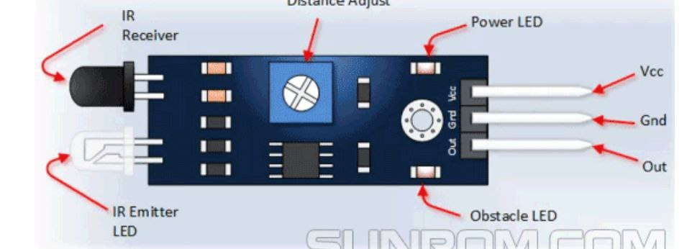
PIR SENSOR
Proximity Sensor are used to detect objects and obstacles in front of sensor. Sensor keeps transmitting infrared light and when any object comes near, it is detected by the sensor by monitoring the reflected light from the object

Slide 8
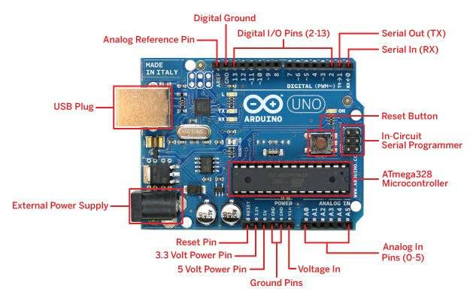
ARDUINO MEGA
Arduino is an open-source physical computing platform based on a simple i/o board and a development environment.
Arduino can be used to develop stand-alone interactive objects or can be connected to software on your computer.

Slide 9
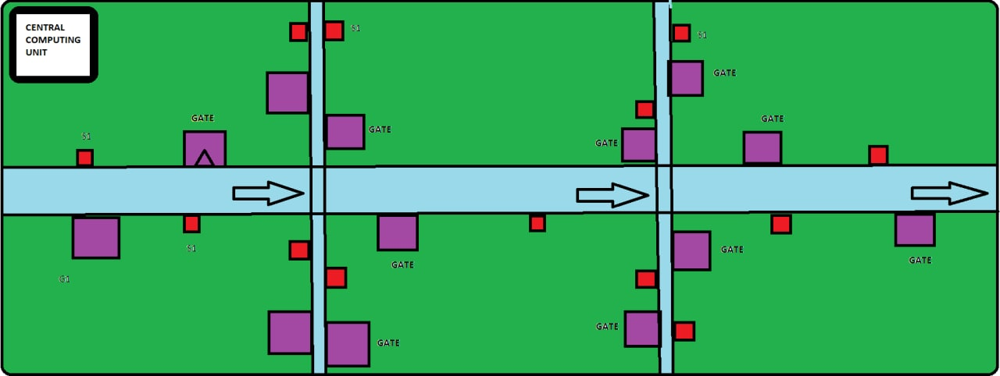
WORKING MODEL

Slide 10
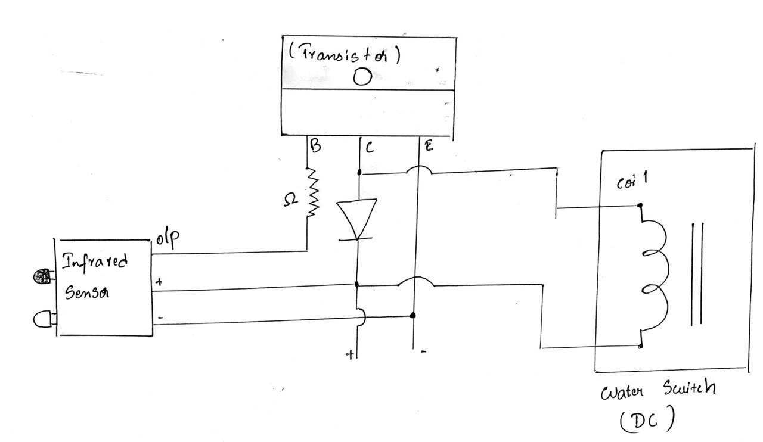
CIRCUIT DIAGRAM

Slide 11
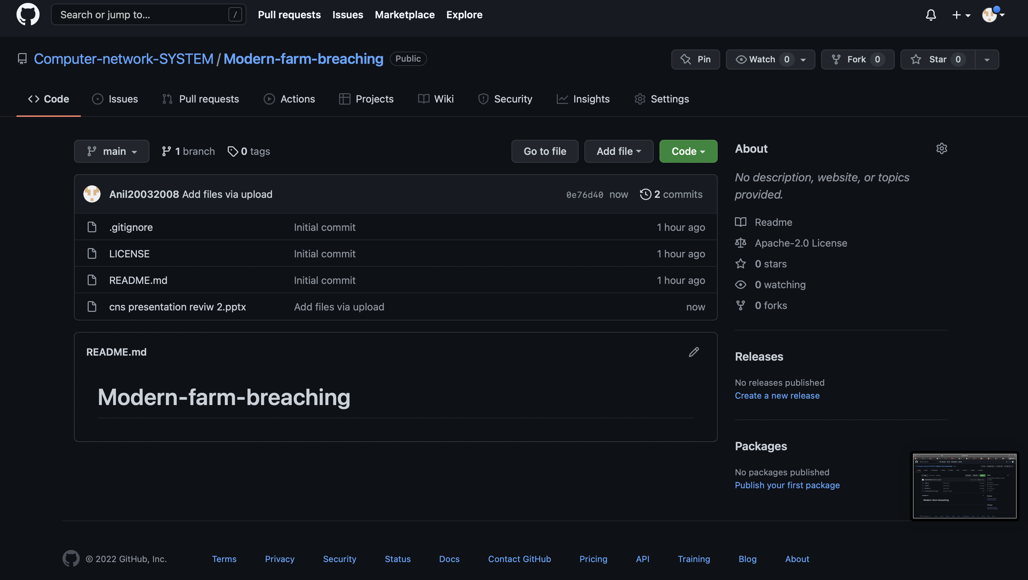
GITHUB COMMITS

Slide 12

THANKYOU

